Slide 1
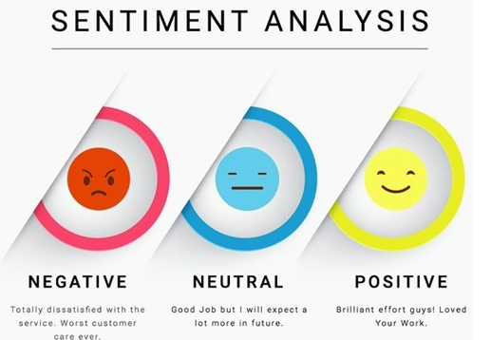

Slide 2
Topics Covered
Introduction
Need Of Sentiment Analysis
Applications
Project Approach
Project Implementation
Advantages
Conclusion

Slide 3

Introduction
Sentiment:
FEELING, EMOTION, AFFECTION, SENTIMENT, PASSION mean a subjective response to a person, thing, or situation.
Sentiment Analysis:
Sentiment analysis (or opinion mining) is a natural language processing (NLP) technique used to determine whether data is positive, negative or neutral. Sentiment analysis is often performed on textual data to help businesses monitor brand and product sentiment in customer feedback, and understand customer needs.

Slide 4

Need Of Sentiment Analysis
To analyze user’s reviews and sentiments for business growth.
To make useful decisions in business.
To improve product/service quality.
To make a relationship between users and product owners
For future growth and decision making.
To improve marketing strategies.

Slide 5
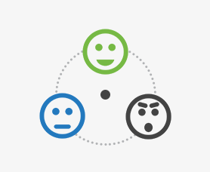
Applications
Businesses and Organizations:
Brand Analysis
New product perception
Product and Service Benchmarking
Social Media:
Finding general opinions about recent hot topic.
Example: Twitter Data Sentiment Analysis

Slide 6

Applications
Ads Placement:
Placing ads in the user-generated content.
Place an ad when one praises a product
Place an ad from a competitor if one dislikes a product.

Slide 7
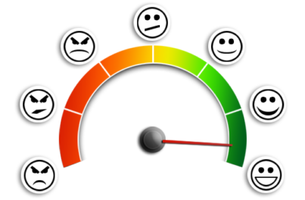
Project Approach
NLP
Use Semantics to understand the language.
Use VaderSentiment
Use Word Tokenization
Use n-grams and Lemmatization
Machine Learning
Don’t have to understand the meaning
Use Classifiers such as Native Bias, SVM

Slide 8
Project Approach
Web UI Development
Use HTML5 for web elements(such as textbox, button, Lebel etc.)
Use CSS3 for designing the web portal.
Use Bootstrap to make it mobile responsive.

Slide 9
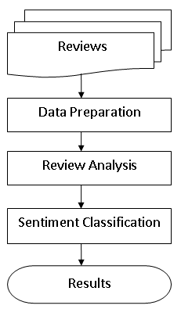
Project Implementation

Slide 10
Project Implementation
Review Analysis
Collect user’s reviews about the product/service in the review area.
Store the reviews in the database(For future business needs)
Data Preparation
Prepare data using nltk library.
Use Tokenization to convert a sentence to word tokens.
Use n-grams and lemmatization for data preparation.

Slide 11
Project Implementation
Review Analysis
Analyze all the reviews using VaderSentiment.
Extract all the sentiment scores from all the tokens.
Sentiment Classification
Based on the sentiment score it is classified.
It can be positive, negative and neutral.
Result
Finally the result is generated. In this project the result is the percentage of positiveness in a review.

Slide 12
Advantages
A lower cost than traditional methods of getting customer's insight.
A faster way of getting insight from customer data.
The ability to act on customer suggestions.
Identifies an organization’s Strengths, Weaknesses, Opportunities and Threats.
More accurate and insightful customer perceptions and feedback.

Slide 13
Conclusion
﻿ We have seen that Sentiment Analysis can be used for analyzing opinions in blogs, articles, Product reviews, Social Media websites, Movie-review websites where a third person narrates his views. We also studied NLP and Machine Learning approaches for Sentiment Analysis. We have seen that is easy to implement Sentiment Analysis via VaderSentiment approach than via Classier approach. We have seen that sentiment analysis has many applications and it is important field to study. Sentiment analysis has Strong commercial interest because Companies want to know how their products are being perceived and also Prospective consumers want to know what existing users think.

Slide 14


